Slide 1
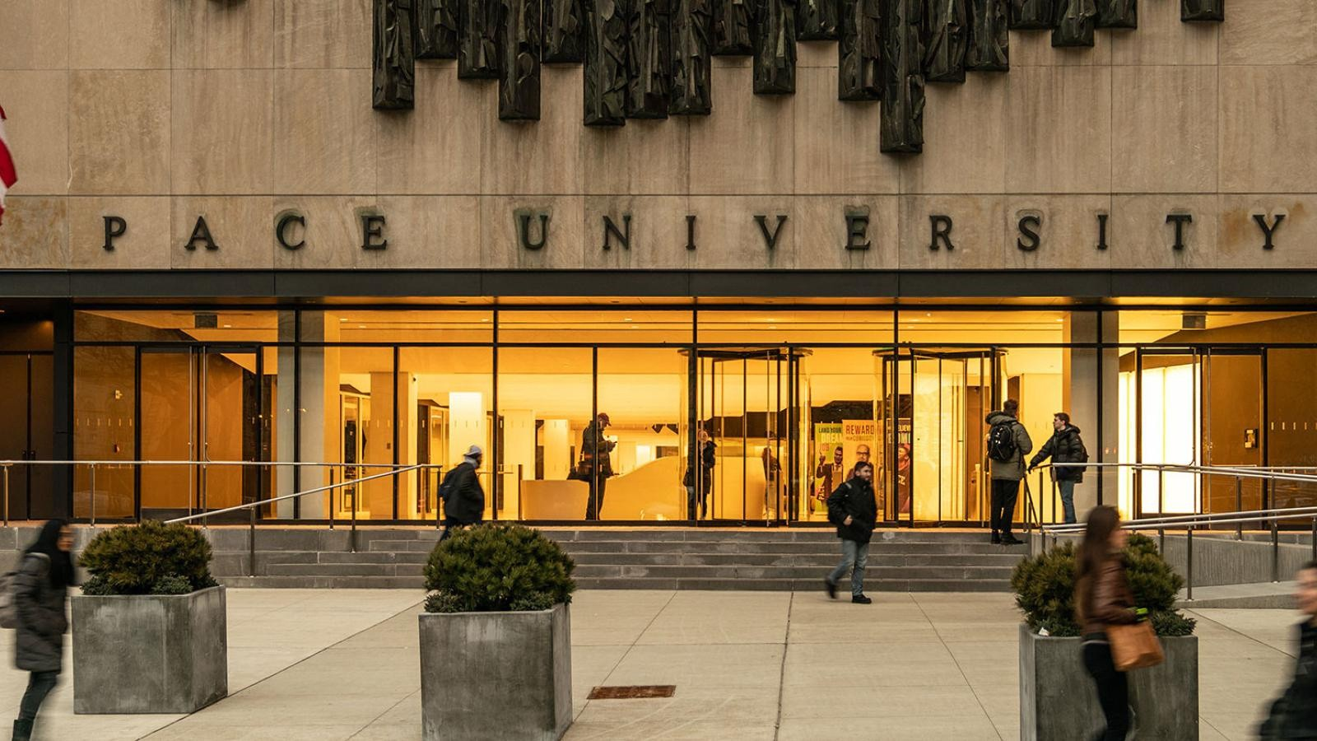

Slide 2

FaceFind
AI-Powered Event Photo Discovery
CS 691
Team 7

Slide 3
AGENDA
Team Member Roles & Responsibilities
Problem Statement & Hypothesis
Project Description
Personas
Technologies
Algorithms
Project Schedule & Cadence
Team Working Agreement
Sprint 0 Retrospective
Group Wiki Page Link

Slide 4
Team Member Roles and Responsibilities
Jash Berawala: Full Stack Lead
Jay Shah: Frontend Developer
• Backend API (Node.js/Express)
• Database Architecture (MongoDB)
• ML Integration
• API Development & Testing
• React.js Application
• Admin Dashboard Interface
• Guest Photo Gallery
• Responsive Design & State Mgmt
Niraj Patil: ML Engineer
Chetan Patel: Database Administrator
• Face Detection & Recognition
• Python Microservice (FastAPI)
• Face Clustering (DBSCAN)
• Model Performance Optimization
• AWS S3 Integration
• CI/CD Pipeline (GitHub Actions)
• Docker Containerization
• Security & QR Code System

Slide 5
Problem Statement
Current Challenges in Event Photography
❌ Manual Photo Distribution
Photographers spend 5-6 hours per event manually sorting and sharing photos
❌ Guest Frustration
Attendees must scroll through hundreds/thousands of photos to find themselves
❌ Delayed Access
Photos delivered days/weeks after events, missing social media engagement window
❌ Privacy & Access Control
No easy way to give specific guests access while maintaining event privacy

Slide 6
Project Description
What is FaceFind?
How It Works
1. Create event → Generate QR
✓ Intelligent web platform automating event photo distribution
✓ Admin Dashboard: Photographers manage events & upload photos
✓ Guest Interface: Attendees discover photos instantly via selfie
✓ AI Engine: Deep learning face detection & clustering
✓ Smart Matching: Cosine similarity for <5 sec results
✓ Built on MERN stack + Python ML microservice
2. Upload photos → AI processes
3. Guest scans QR → Takes selfie
4. System matches faces
5. Personalized gallery delivered

Slide 7
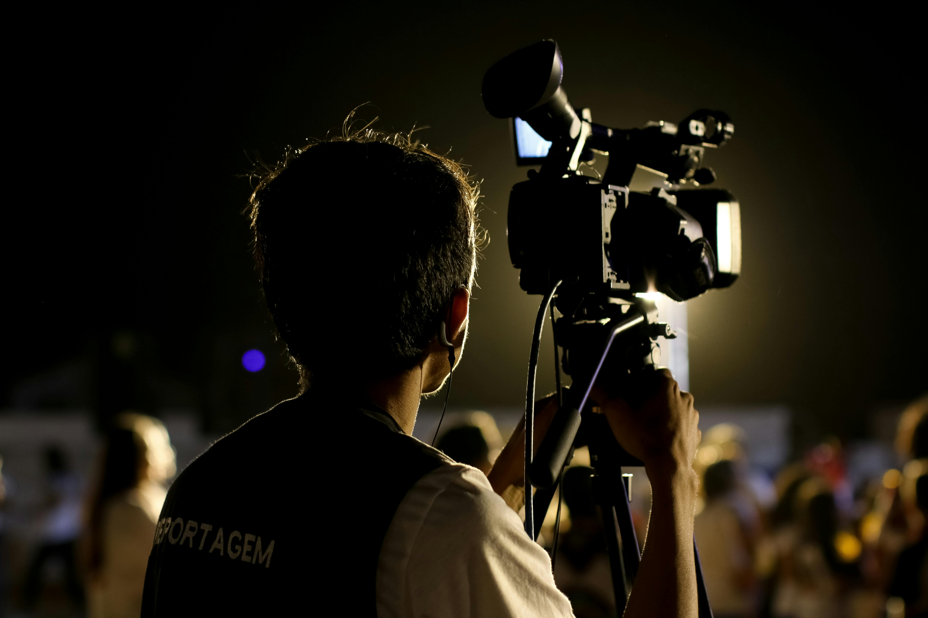
Persona 1 — The Photographer : “Alex the Memory‑Maker”
Background:
Full-time photographer shooting 3-4 events/week. Spends 5-6 hours manually organizing and sharing photos per event.
Goals:
• Reduce photo delivery time from hours to minutes
• Improve client satisfaction with faster turnaround
• Focus more on photography and client acquisition
Pain Points:
• Manual folder creation and link sharing
• Constant client requests: 'When will photos be ready?'
• No easy way to provide partial access
How FaceFind Helps:
Creates event in 30 seconds, AI handles distribution, guests self-serve via QR code, frees 5+ hours per event

Slide 8

Persona 2: Wedding Guest - Marcus Thompson
Background:
28-year-old marketing manager, attends 8-10 weddings/year. Frustrated by delayed photo access.
Goals:
• Get photos immediately while memories are fresh
• Easily find photos of himself without scrolling
• Share to social media during the event
Pain Points:
• Receives photo links 3-4 weeks after events
• Must scroll through 800+ photos to find himself
• Misses social media engagement window

Slide 9

Persona 3 — The Event Organizer: “Jordan the Coordinator”
Background:
Senior Events Manager organizing 15-20 company events annually. Needs secure, measurable photo distribution.
Goals:
• Quick, secure photo delivery to employees
• Track engagement and measure ROI
How FaceFind Helps:
Private events with email whitelist, detailed analytics, 73% engagement in 48hrs

Slide 10
Technologies
Frontend
Backend
Machine Learning
• React.js
• Redux Toolkit
• Tailwind CSS
• Socket.io Client
• Node.js + Express
• MongoDB + Redis
• JWT Auth
• Socket.io
• Python + PyTorch
• FastAPI
• InsightFace
• OpenCV + NumPy
Cloud & DevOps
Complete MERN Stack
• AWS S3 + CloudFront CDN
• Docker Containers
• GitHub Actions (CI/CD)
• Nginx Reverse Proxy
MongoDB + Express + React + Node.js
+ Python ML Microservice
+ Cloud Infrastructure (AWS)

Slide 11
Algorithms
Machine Learning / AI Algorithms Used
Face Detection: MTCNN / RetinaFace
Face Embedding: ArcFace (InsightFace)
Similarity Search: FAISS / pgvector
Clustering (Future): K‑Means / DBSCAN
Pattern Recognition: Deep Learning CNNs

Slide 12
Project Schedule & Cadence
Sprint Cadence
Sprint Length: 2 weeks
Daily Standup: 15 minutes
Sprint Planning: Start of each sprint
Sprint Review: End of each sprint
Retrospective: End of each sprint
Weekly Tech Sync: Twice per week

Slide 13

Team Working Agreement
This agreement outlines the expectations, responsibilities, and commitments of all team members throughout the duration of the project. By signing this document, each member agrees to uphold the standards listed below to ensure a productive, respectful, and collaborative working environment.
1. Communication
The team will use Slack / Microsoft Teams/ Google Meet as the primary communication platform.
All members agree to respond to messages within 12 hours.
Important updates, blockers, or delays must be communicated promptly and transparently.
2. Meetings
All team members agree to:
Attend all sprint ceremonies, including:
  Sprint Planning
  Daily Standups

Slide 14
Team Working Agreement
3. Work Expectations
Each team member commits to:
Completing assigned tasks before the deadline.
Avoiding last‑minute submissions that create unnecessary pressure on others.
Submitting work for peer review before merging into the main branch.
Communicating blockers early so the team can assist and adjust accordingly.
4. Accountability
If a team member cannot complete a task, they must notify the team immediately.
The team agrees to maintain a supportive, no‑blame culture.
Each member is responsible not only for their own tasks but also for contributing to the overall success of the sprint.
5. Team Values
We agree to uphold the following values:
Respect for each other’s time, effort, and contributions
Honest and open communication
Collaboration and willingness to help teammates
Professionalism, positivity, and shared ownership of outcomes

Slide 15
Retrospective
What Went Well
Clear understanding of project vision
Roles assigned effectively
Strong alignment on architecture
Good communication setup
What Can Be Improved
Need more clarity on data flow diagrams
Improve time estimation accuracy
Actions for Next Sprint
Create detailed architecture diagrams
Build initial FastAPI + Next.js skeleton
These become Sprint 1 backlog items

Slide 16
Group Wiki Page Link https://github.com/JashBerawala/Pace-Project-Team7/wiki

Slide 17

Thank you

